Slide 1
Game of life
A brief history
Run Zhang
C&I Cloud Platform Engineering

Slide 2
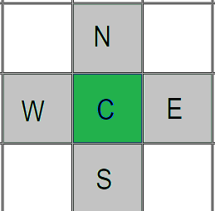
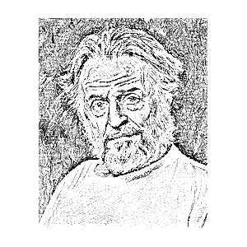
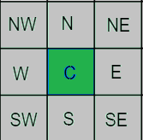
Game Rule
John Conways
Any live cell with fewer than two live neighbors dies, as if by underpopulation.
Any live cell with two or three live neighbors lives on to the next generation.
Any live cell with more than three live neighbors dies, as if by overpopulation.
Any dead cell with exactly three live neighbors becomes a live cell, as if by reproduction.
Simulate living organism based on John Von Newman’s conjecture

Slide 3
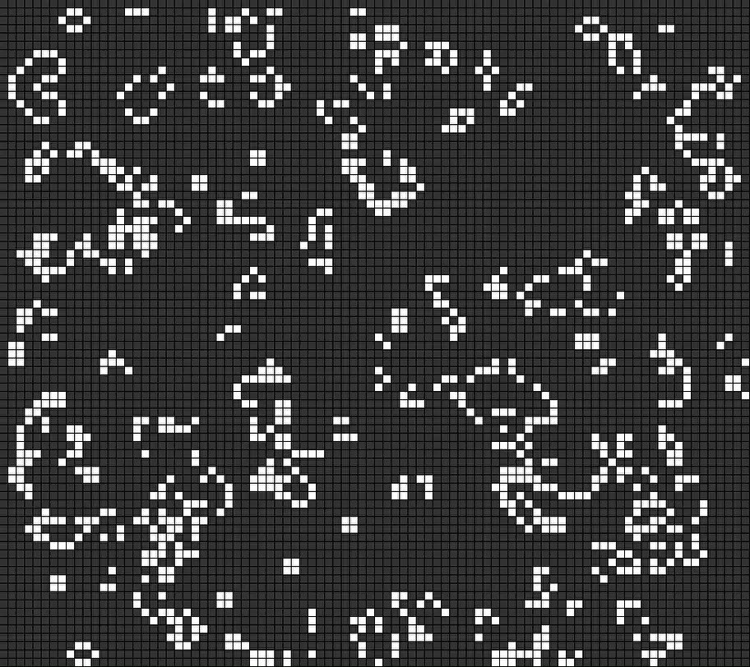
Still life and Oscillator

Slide 4
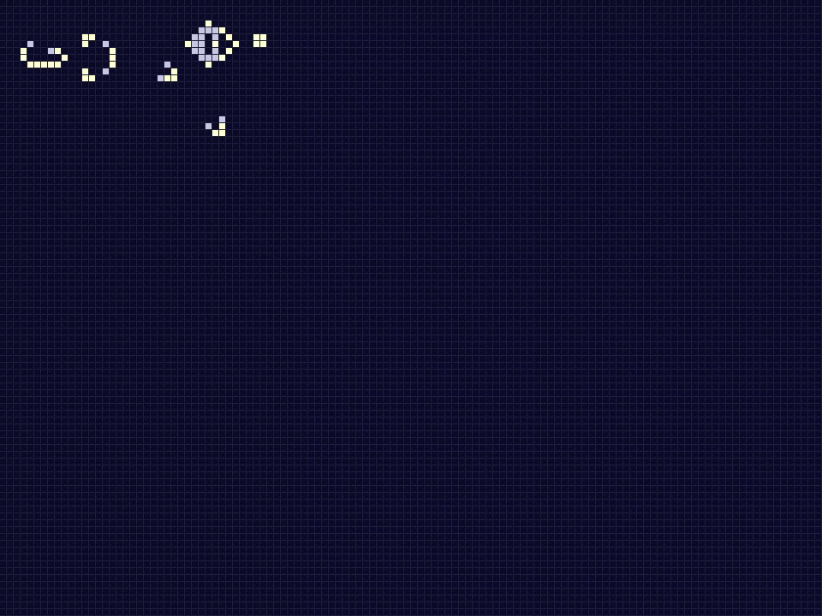
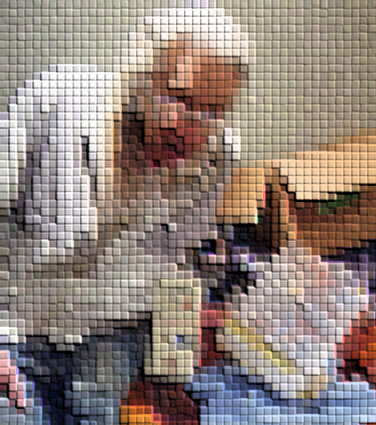
Gosper glider gun
Bill Gosper

Slide 5
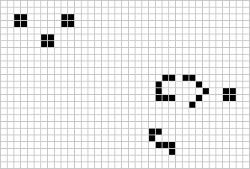
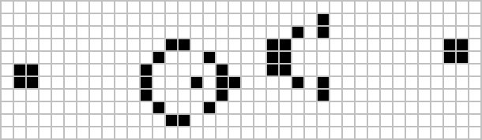
Simkin glider gun
120 …
36
15,30…
2015
1970

Slide 6
The Breeder
Puffer train running though the universe
leaves glider gun in its wake which in
turn create gliders

Slide 7
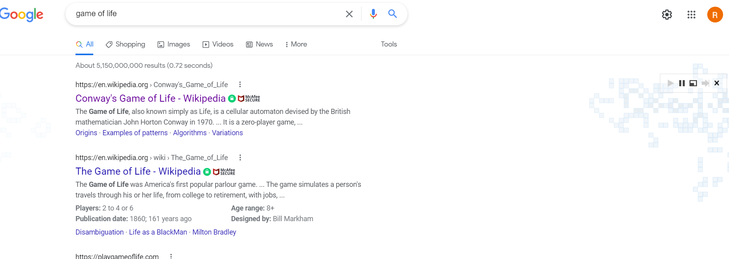
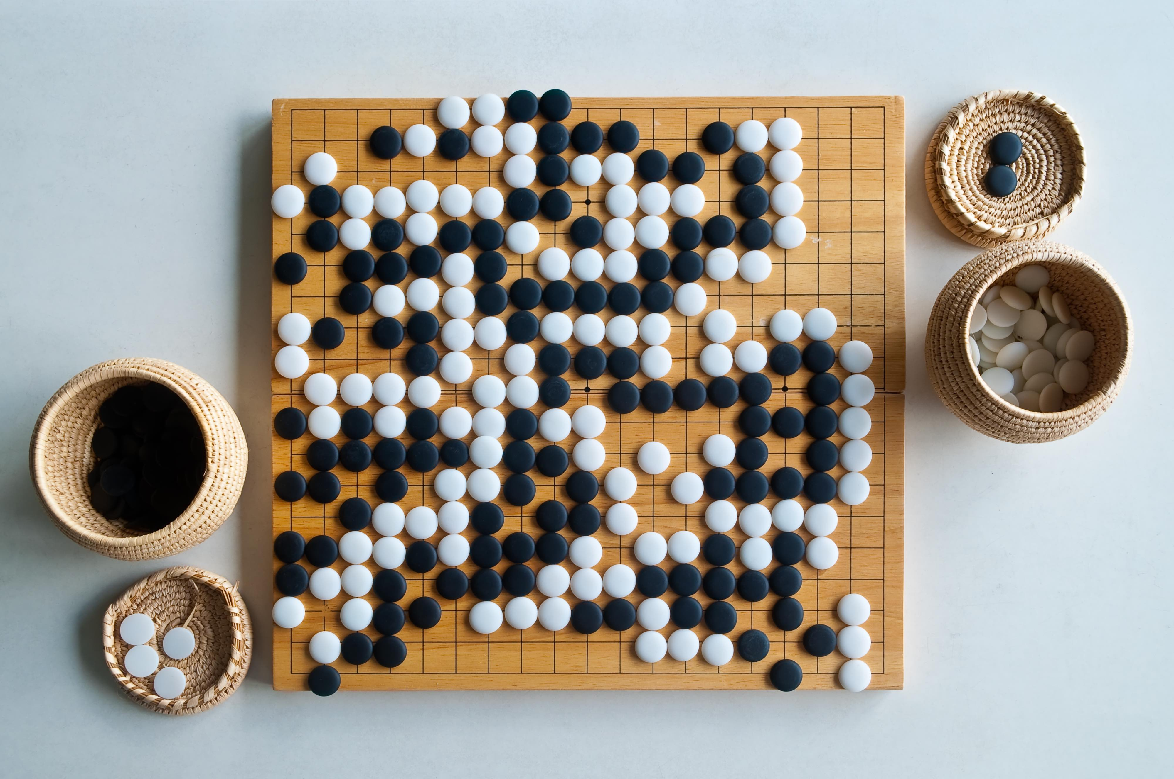
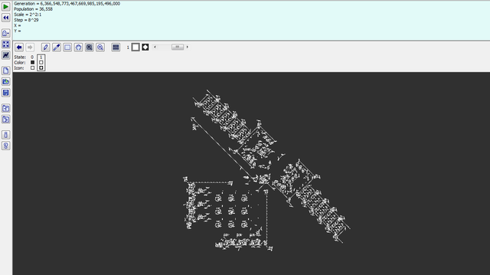

Play the game
Google
Go
Golly

Slide 8
END

